Slide 1



WP2 progress
CGMS Anhui/Morocco
Allard de Wit, Steven Hoek, Riad Balaghi, Tarik el Hairech, Bell Zhang, Jappe Franke, Hugo de Groot, Bas vanMeulebroek, Zhiyi Zhou

Slide 2
WP2: Deliverables
Deliverable | Name | Status | Submitted/ expected
D22.1 | Morocco usability report | Accepted | 30 June
D22.2 | Morocco adaptation strategy report | Accepted | 31 August
D22.3 | Adapted CGMS version Morocco | In progress | Month 33
D22.4 | CGMS Piloting Morocco | In progress | Month 33
D23.1 | Anhui usability report | Accepted | 30 June
D23.2 | Anhui adaptation strategy report | In progress | 31 December ?
D23.3 | Adapted CGMS model for regional application in Anhui, China | TBD | Month 33
D23.4 | CGMS Piloting Anhui China | TBD | Month 33

Slide 3
WP2.2 Status CGMS Morocco
Building CGMS level 1 archive almost completed:
  Calibration of radiation models
  Vapour pressure estimates
Real-time operations still pending
Progress has been delayed due to accident involving Tarik El Hairech
Usefulness CGMS-MA for monitoring 2013 growing season becomes critical!

Slide 4
WP2.2: work carried out
  Analysis on the poor performance of default CGMS in Morocco
  Modifications done:
    Redefined crop calendar
    Recalibrated phenology
    Adapted water balance initialization
  Testing against regional statistics for improvements

Slide 5
Poor performance of CGMS Europe in Morocco
Indicator no. | Indicator name | R: Durum wheat | R: Soft wheat
1 | Potential Above Ground Biomass | -0.095 | -0.029
2 | Potential Storage Organs | -0.157 | -0.148
3 | Water Limited Above Ground Biomass | 0.374 | 0.368
4 | Water Limited Storage Organs | 0.398 | 0.344
5 | Cum. rainfall September to May | 0.777 | 0.729
Assumptions underlying application of CGMS in Europe for winter-wheat:
  Model starts on the 1st of January
  Water balance is initialized at field
  capacity

Slide 6
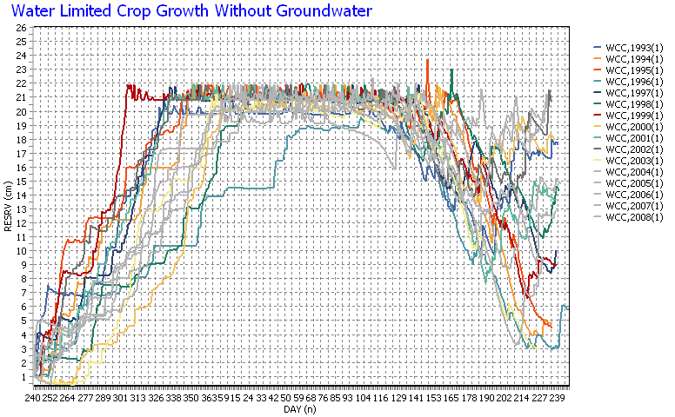
Soil moisture for w-wheat simulation (wageningen NL)

Slide 7
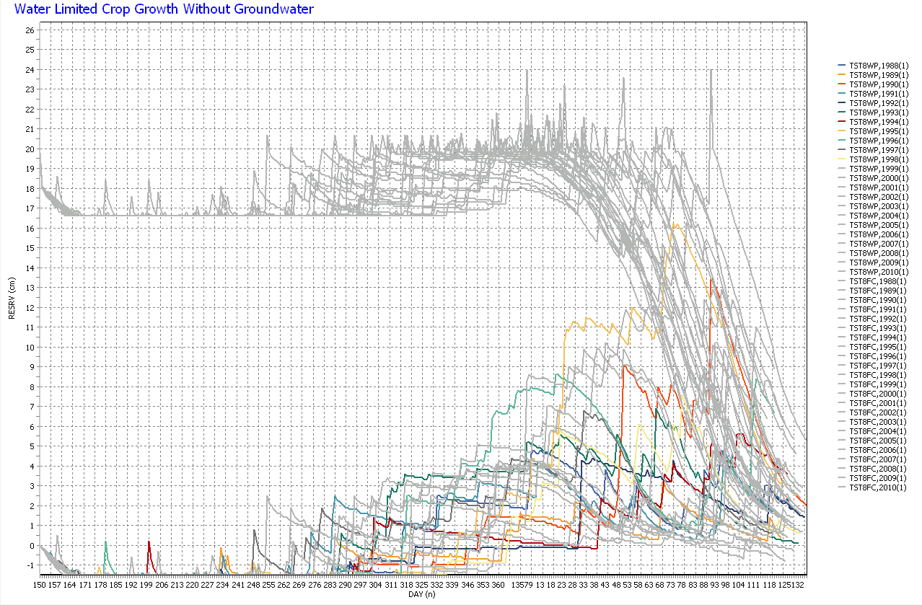
Soil moisture for w-wheat simulation (Tassaout MO)

Slide 8
Phenological calibration
Tsum1/2: (1350/750, 1370/800)

Slide 9
CGMS Morocco: improvements
Model starts at real sowing date (1st December), not 1st of January
Updated phenology parameters
Water balance starts at 1st of June with completely dry soil profile
Aggregation to regions based on land cover mask and Morocco regional statistics.

Slide 10
Correllation with crop yield statistics (whole Morocco)

Slide 11
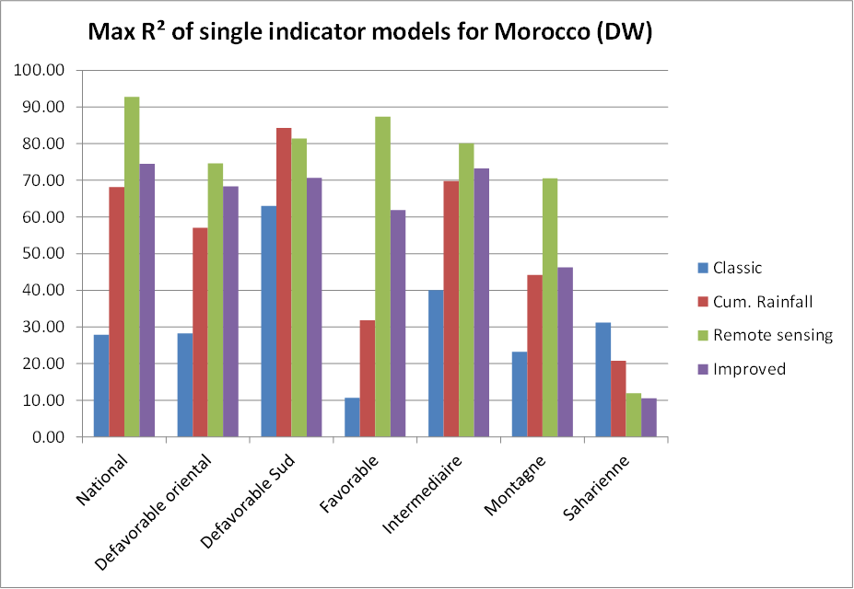
Correllation with crop yield statistics (regional level)

Slide 12
Conclusions on CGMS adaptation Morocco
The phenological parameters of WOFOST were calibrated on the Moroccan experimental data.
Assumptions used in CGMS-Europe for winter-wheat are poor for Morocco
The adapted CGMS using the new crop calendar, new WOFOST phenological parameters and adapted water balance initialization performs considerably.
Further improvements of CGMS for Morocco can perhaps be obtained using better data:
  (weather, soil) from the Moroccan institutes
  use of a variable sowing date (local rainfall pattern).
  Calibration of additional parameters -> link with
  WP3
modelling of wheat growth in the southern provinces could be improved if the special growing conditions are taken into account that are prevalent there.

Slide 13
CGMS Anhui: status
CGMS Anhui Level 1 archive finished
Problem: no real-time meteo data from Chinese MetOffice
Use NOAA Global Summary of the Day for real-time data → implementation pending
Crop calendar and sowing dates defined
Preliminary calibration of winter-wheat done based on a regional crop calendar
Need to test current setup and benchmark performance
Visit of Bell Zhang to Alterra in September

Slide 14
Work on WP2.3:
CGMS Anhui adaptation
Deliverable 23.2 CGMS Adaptation report Anhui
  Literature study on yield determining factors in Anhui
  Building of questionnaire to start collecting information from Chinese researchers
Yield determining factors from literature in Anhui:
  Disease: wheat scab disease caused by large amount of rainfall and large number of rainy days during Anthesis
  Flooding, waterlogging and drought
  Long periods of dark, cold and rainy weather in spring
  Insufficient availability of good wheat varieties adapted to Anhui
  Improper crop management (too high sowing density)

Slide 15
Work on WP2.3:
CGMS Anhui adaptation
Questionnaire designed to verify results from literature study on wheat variability in Anhui
Internet-based survey using http://qualtrics.com
Questionnaire tries to retrieve information on impact of yield determining factors:
  Direct weather factors (drought, frost, etc.)
  Indirect factors (disease related)
  Management factors (sowing problems, nutrients, etc)
Open questions on yield variability in Anhui based on the statistical data in Anhui.
Both English and Chinese version available

Slide 16
Work on WP2.3:
CGMS Anhui adaptation

Slide 17
WP2: e-Agri viewers
Successful implementation of e-Agri needs platform for analysis of results:
  Integrated analysis of meteo, satellite and model results
  Multiple users on multiple locations (e.g. Morocco)
  web-based solution seems most appropriate (as MARS viewers)
Started development of viewers for e-AGRI

Slide 18
e-Agri viewer design
Based Luigi web framework (as are MARS viewers): http://sourceforge.net/projects/luigios
Development based on PostgreSQL database (support for ORACLE to be added)
Viewer based on Flex4 largely ready
Major work currently on dataserver to provide E-Agri data (meteo, satellite, model results)
Simplified compared to MARS viewers

Slide 19
Conclusions
Good progress on deliverables
Need to make progress on CGMS Morocco/Anhui implementation:
  Calibration (link with WP3)
  real-time operations
Good progress on E-Agri viewers: formally not a deliverable

